Slide 1
Introduction to Learning

Slide 2
Introduction to Learning
An agent is learning if it improves its performance after making observations about the world.
Learning can range from the trivial, such as jotting down a shopping list, to the profound, as when Albert Einstein inferred a new theory of the universe.
When the agent is a computer, we call it machine learning: a
computer observes some data,
builds a model based on the data,
uses the model as both a hypothesis about the world and a piece of software that can solve problems.

Slide 3
Why Machine Learning?
Why would we want a machine to learn?
Why not just program it the right way to begin with?

Slide 4
What is ML?
Machine learning (ML) is the study of computer algorithms that improve automatically through experience.
Machine-learning algorithms use statistics to find patterns in massive amounts of data.
Traditionally, software engineering combined human created rules with data to create answers to a problem. Instead, machine learning uses data and answers to discover the rules behind a problem – F. Chollet, Deep Learning with Python

Slide 5
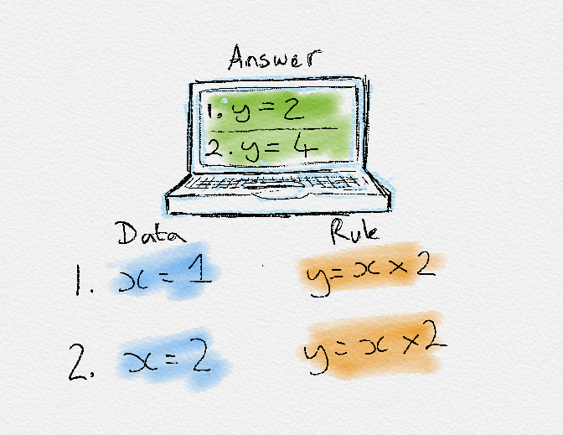
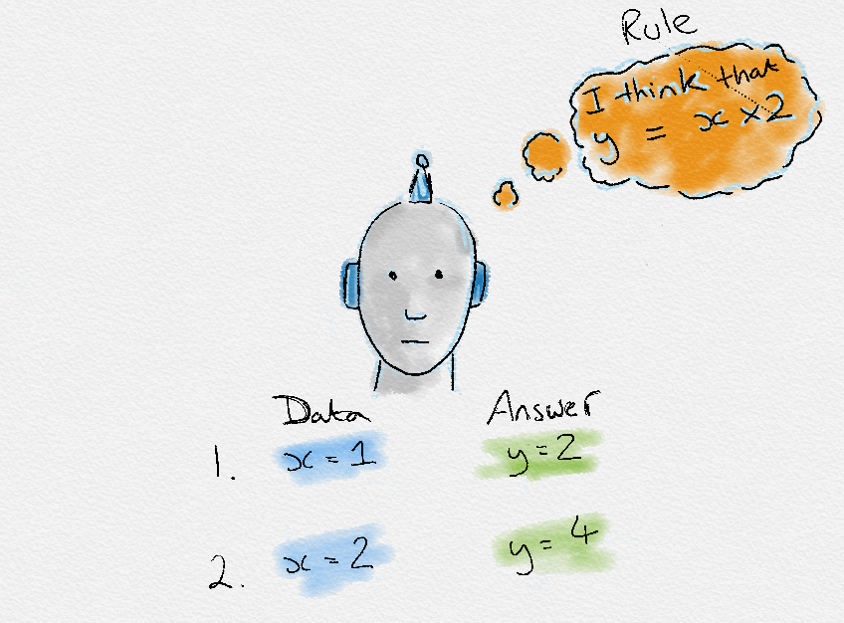
What is ML?
Traditional Programming
Machine Learning
Machine Learning

Slide 6
Terminologies used in ML
ML systems learn how to make inference from the input data samples to produce useful predictions on un-seen (test) data.
Input data:
labelled examples: A labelled example includes feature(s) and the label. {features, label}: (x, y)For e.g.:
unlabelled examples: An unlabelled
example contains features but not
the label. {features, ?}: (x, ?)
For e.g.:
Features: | Label
Normal RBC, Normal HgB | Healthy
Low RBC, Low HgB | Anaemic
Features:
Housing type: 4BHK, Price: 40,000
Housing type: 4BHK, Price: 15,000
Housing type: 2BHK, Price: 25,000
Housing type: 2BHK, Price: 8,000

Slide 7
Terminologies used in ML
Machine Learning Model:
A ML model defines the relationship between the features and label.
For e.g.: An anaemia diagnostic model might associate certain features strongly with “anaemic“ or “healthy”, and predict the labels based on the association rules it inferred.
Two Phases of ML model development
Training means creating or learning the model.
Testing/Inference means applying the trained model to unlabelled examples.

Slide 8
Applications
Hand-written digit recognition
Speech recognition
Face detection
Object classification
Email spam detection
Computational biology
Autonomous cars
Computer-aided diagnosis

Slide 9
Relation with Other Fields
Mathematics
Document Analysis
Signal Processing
Physics
Computer Vision
Machine Learning
Medical Image Analysis
Artificial Intelligence
Neuroscience
Robotics
Engineering
Algorithms, Graphics…
Biology
Computer Science

Slide 10
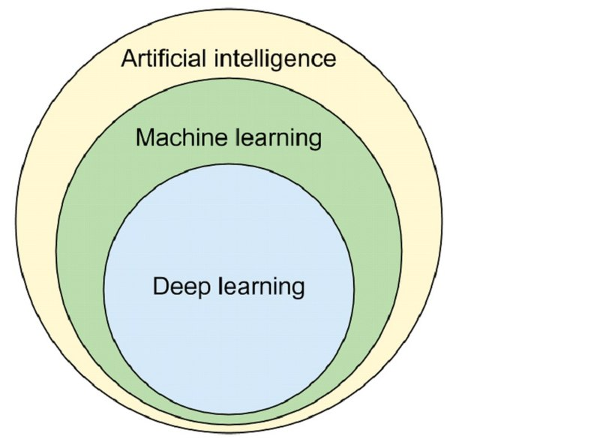
Relation with AI, ML and DL

Slide 11
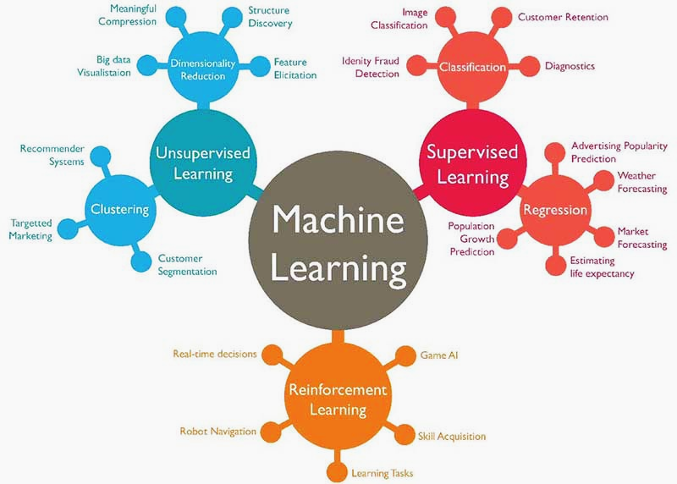
Different Machine Learning Paradigms

Slide 12
Bayesian Learning
ML works with data and hypotheses.
Here, the data are evidence—that is, instantiations of some or all of the random variables describing the domain.
The hypotheses are probabilistic theories of how the domain works, including logical theories as a special case.
Bayesian learning simply calculates the probability of each hypothesis, given the data, and makes predictions on that basis.
i.e, the predictions are made by using all the hypotheses, weighted by their probabilities, rather than by using just a single “best” hypothesis.

Slide 13
Bayesian Learning
Marginal Probability: The probability of an event irrespective of the outcomes of other random variables, e.g. P(A).
Joint Probability: Probability of two (or more) simultaneous events, e.g. P(A and B) or P(A, B).
Conditional Probability: Probability of one (or more) event given the occurrence of another event, e.g. P(A given B) or P(A | B)

Slide 14
The joint probability can be calculated using the conditional probability; for example:
P(A, B) = P(A | B) * P(B)
This is called the product rule. Importantly, the joint probability is symmetrical, meaning that:
P(A, B) = P(B, A)
The conditional probability can be calculated using the joint probability; for example:
P(A | B) = P(A, B) / P(B)
The conditional probability is not symmetrical; for example:
P(A | B) != P(B | A)

Slide 15
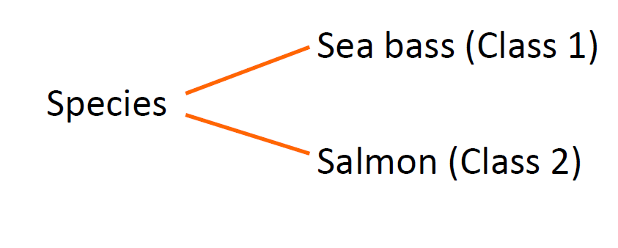
An Example
“Sorting incoming Fish on a conveyor according to species using optical sensing”
Bayesian Decision Theory Primary source of reference: Pattern Classification – Duda and Hart

Slide 16
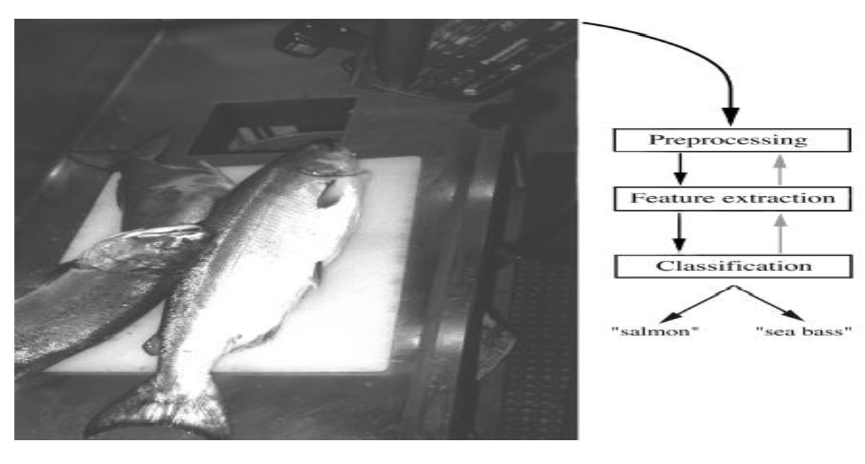

Slide 17
Problem Analysis
Set up a camera and take some sample images to extract features like
Length of the fish
Lightness (based on the gray level)
Width of the fish

Slide 18
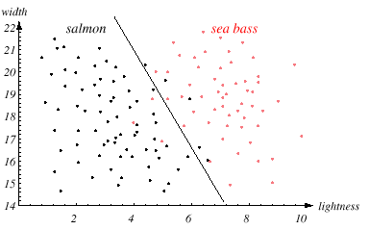

Slide 19
Prior knowledge
The sea bass/salmon example (a two class problem)
For example if we randomly catch 100 fishes and out of this if 75 are sea bass and 25 are salmon.
Let the rule, in this case is: For any fish say its class is sea bass.
What is the error rate of this rule?
This information which is independent of feature values is called apriori knowledge.

Slide 20
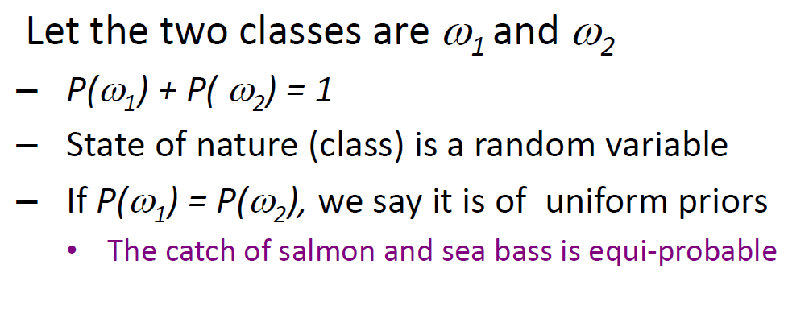

Slide 21
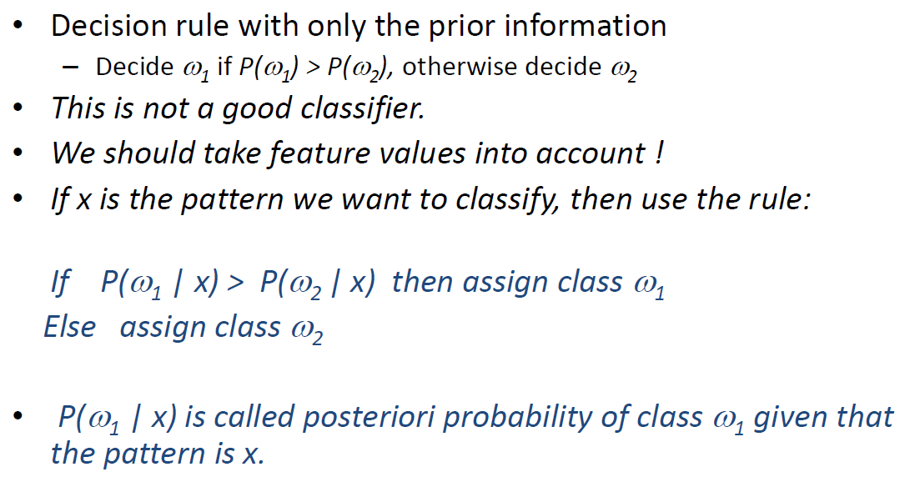

Slide 22
Bayes rule
From data it might be possible for us to estimate p( x | Ꙍ_{j} ), where i = 1 or 2. These are called class-conditional distributions.
Also it is easy to find apriori probabilities P(Ꙍ₁) and P(Ꙍ₂) . How this can be done?
Bayes rule combines apriori probability with class conditional distributions to find posteriori probabilities.

Slide 23
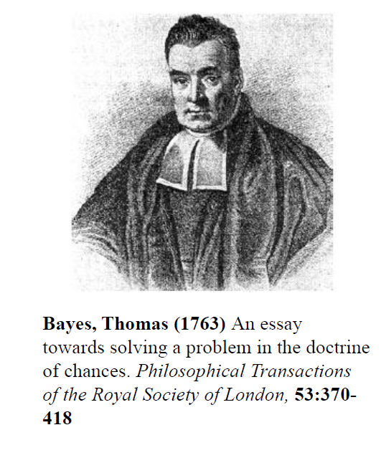
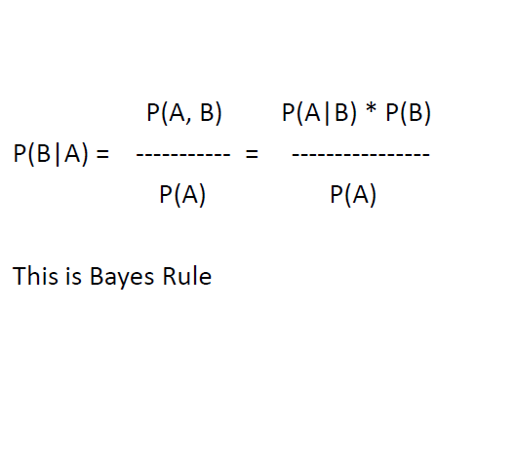
Bayes rule

Slide 24
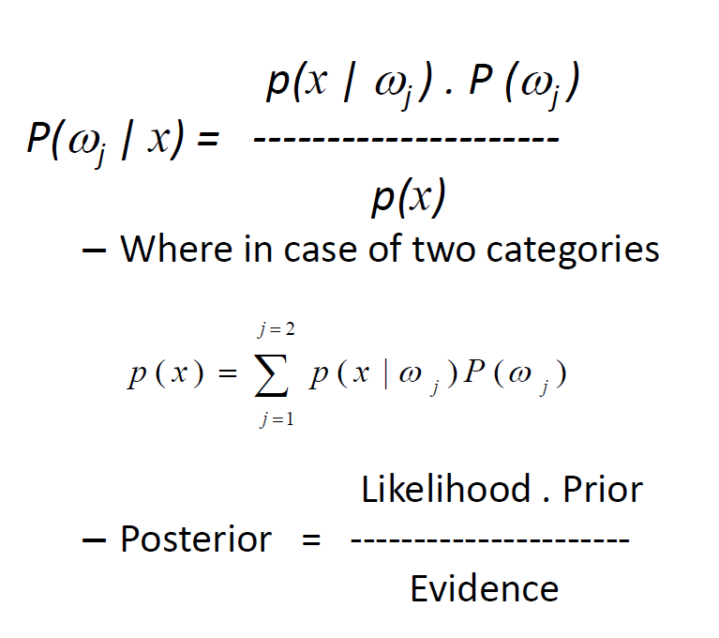

Slide 25
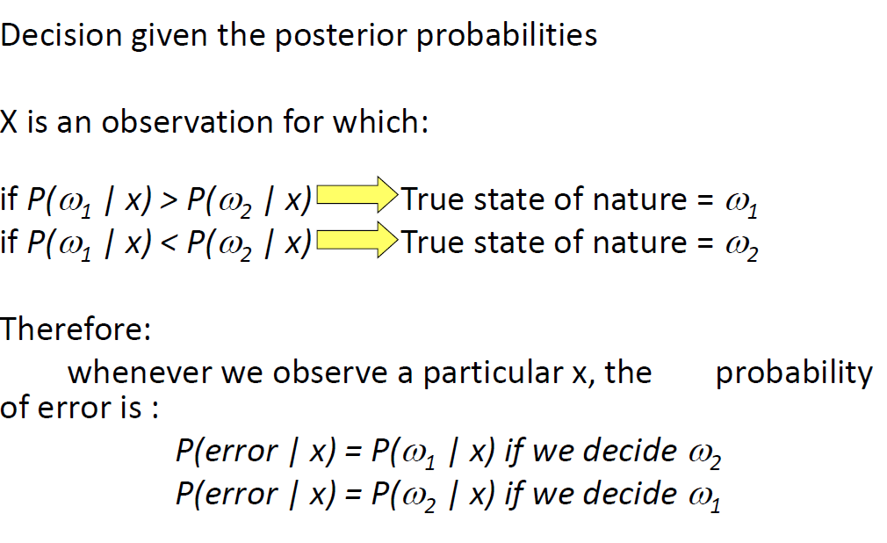

Slide 26
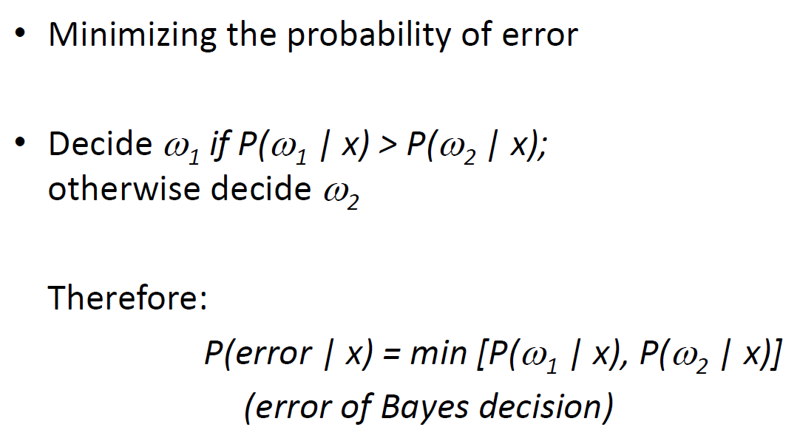

Slide 27
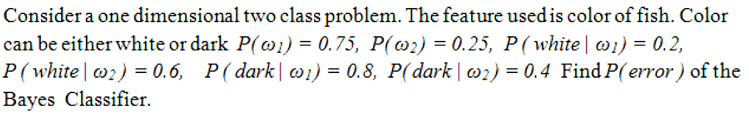


Slide 28


Slide 29
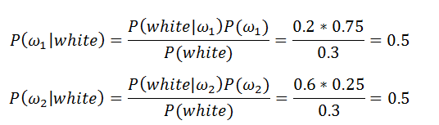

Slide 31
But, what is the error, if we use only apriori probabilities?

Slide 32
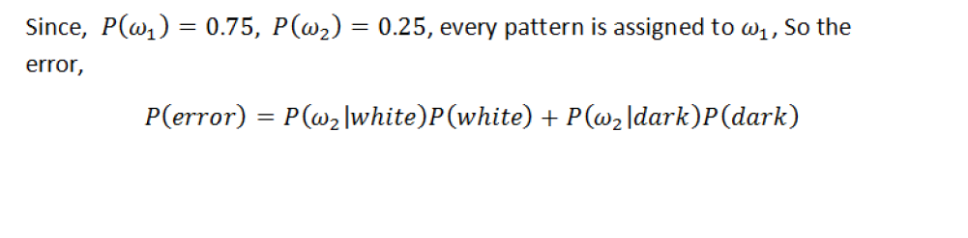

Slide 33
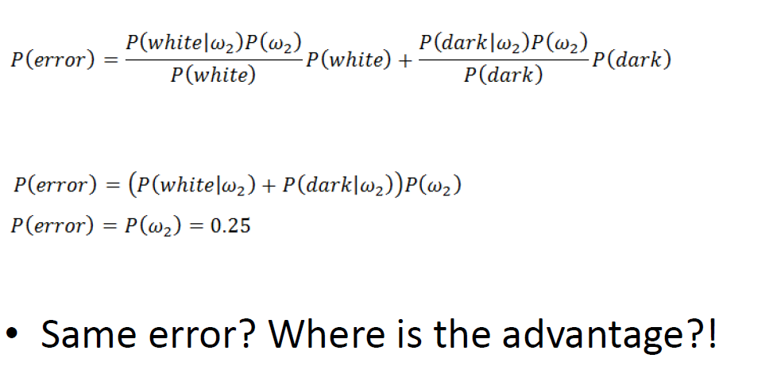

Slide 34
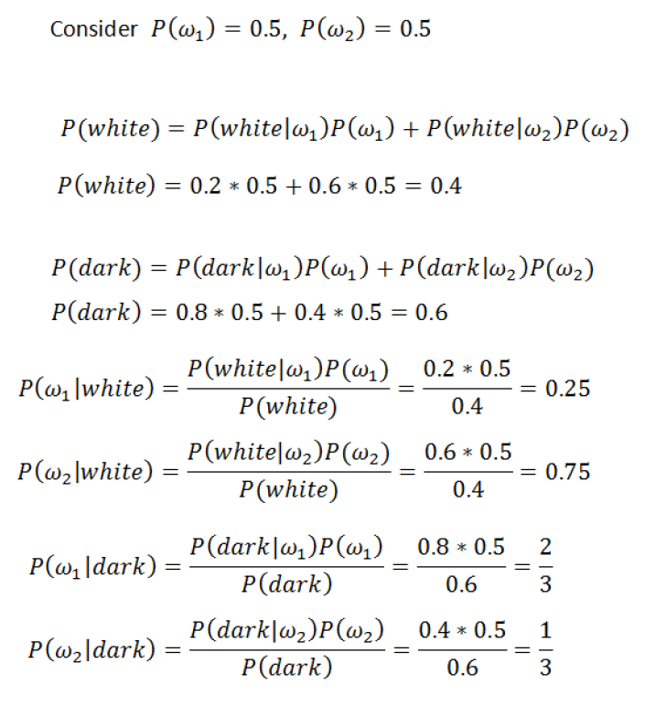

Slide 35
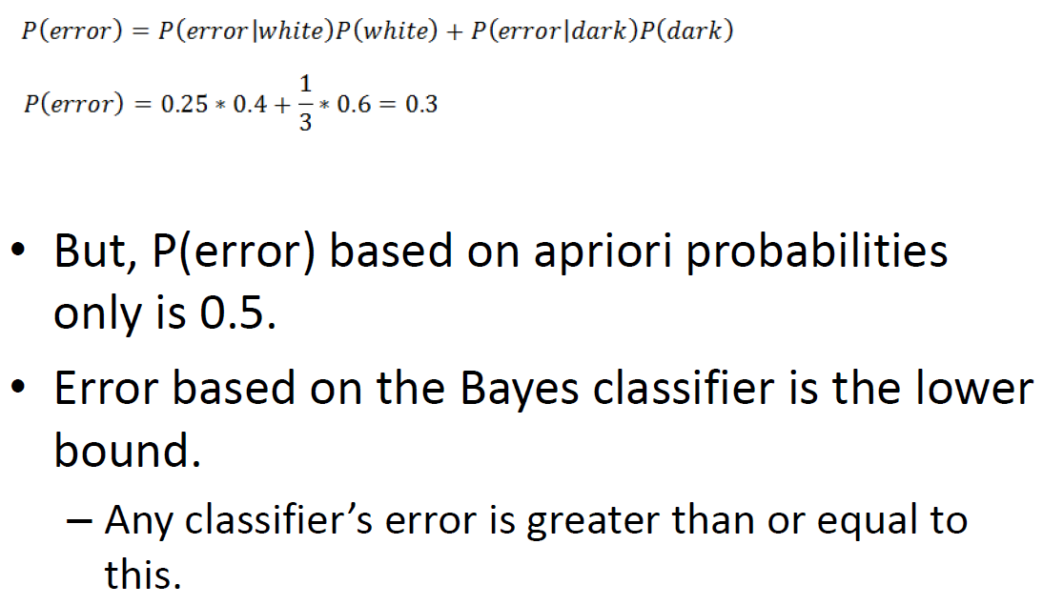

Slide 36
Read Duda and Hart book.

